Slide 1
Neighborhood Complete Streets
Shared Streets Pilot Projects
Bluemont Civic Association
January 31, 2024
Brian Shelton – Project Manager
Michelle Stafford – NCS Program Manager

Slide 2
Outline
Program Background - Neighborhood Complete Streets
What are Shared Streets?
Shared Streets Pilots
Public Engagement - What we heard from you
Project Timeline

Slide 3
Neighborhood Complete Streets Program
2013-2014
2017
2018-2019
2020-2023
Transition from Neighborhood Traffic Calming (NTC) to Neighborhood Complete Streets (NCS)
First Applications received
Pilot Projects
Capital Projects approved annually
The goal of the Neighborhood Complete Streets program is to address issues of safety and access on local streets, as overseen by the Neighborhood Complete Streets Commission

Slide 4
NCS Project Selection Process
Locations are nominated by the public, scored and ranked on objective criteria, then selected by the Commission
Projects follow the 6-Step Guide to Public Engagement, and are recommended for approval at a public Funding Hearing of the NCSC, then approved by the Arlington County Board
The NCS program has funded 4 pilot and 9 capital projects to date, for a total of $4.25m in improvements on Arlington’s neighborhood streets

Slide 5
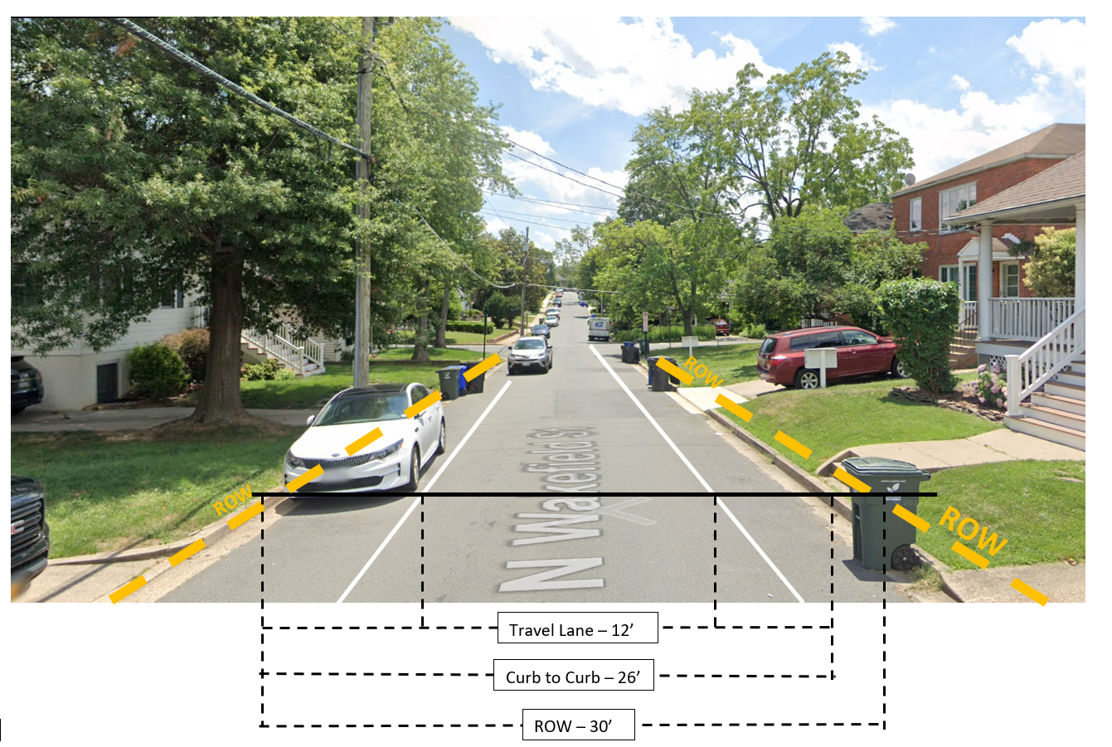
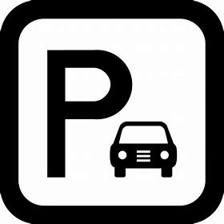
Balancing Priorities on N. Wakefield Street
Street trees
On-street parking
Right of way availability
Utility poles
Project costs
Bicycle Infrastructure
Pedestrian Infrastructure
Emergency service clear width

Slide 6
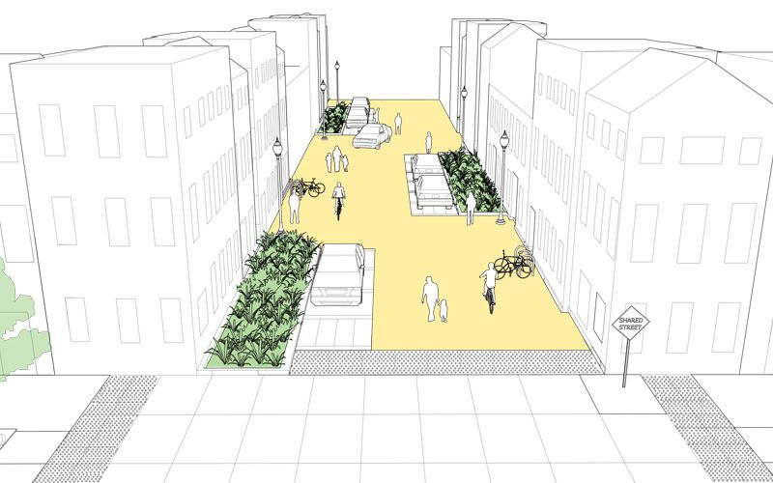
NACTO Guidance on Shared Streets
Midblock Treatments Options
Chicanes and other design features to slow traffic
Bike Racks and Corrals
Street Entrance Treatments
Advisory Signs
Reduced Speed Limit (cautionary)
Street Entrance Narrowed
Curb Extensions
Pavement Markings
Notes:
"A shared street is a local street where the needs of motor vehicles are generally secondary to the needs to pedestrians, bicyclists and other roadway users."
(pg. 29 MTP Streets Element)
When discussing shared streets in the past with the NCS commission and in our internal meetings we use the nacto recommendations as a guide to give a general idea of what a neighborhood shared street could be in Arlington. We like to point out that with these pilots we are not proposing eliminating curbs or reducing setbacks.
What we do reference in the illustration are many of the tools and design features which improve pedestrian comfort and reduce driver speeds. .
These can be broken down into midblock and street entrance treatments.
The Arlington County multimodal safety engineering toolbox contains most of these treatments to slow traffic at the midblock and at the entrance to the streets.
Similar to the illustration and where there is enough space in the right of way we can provide other features i.e. bike racks and corrals, bio-retention facilities used as chicanes to help reduce automobile speeds.
What we are missing from the toolbox are tools which complete the shared street Entrance Treatments, these are advisory signs, and pavement markings. Both treatments, which you will see in the following slides are designed to eliminate the ambiguity of how the street is intended to be use – to reinforce that the three streets selected for this pilot are shared streets
*** Nacto recommends shared streets where roadway Average Daily Traffic is less than 3000 vehicles per day

Slide 7
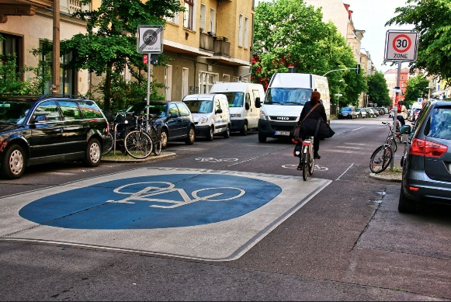
Example Street Entrance Precedents
Notes:
There were two preferred pavement and sign precedents which came out of the discussion. The image on the left is a Fahrradstrasse (Bicycle street) pavement marking. These are found in many towns and cities throughout Germany. The “bicycle street” pavement markings are installed on streets where cycle traffic is intended to take precedence over motorized vehicle traffic.
The large shape in conjunction with the roadway signs eliminates ambiguity of how the street is intended to be used – large enough to catch the attention of drivers
With these two examples we were able to generate Arlington Specific treatments.
Focus on Arlington Specific

Slide 8
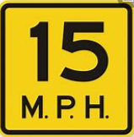
Street Entrance Concepts
Terra Cotta Color
Shared Street text to reinforce the use of the street – “Branding”
12” White Border optional can improve visibility
SHARED
STREET
Font and font size to meet specifications
Bike and Ped symbol to specifications
Font and Size to meet specifications to account for stretch.
15 mph recommended per MTP
Can be placed below the circle
Diameter to span the Travel Lane Width
Notes:
We discussed the designs with TE&O, and Vision Zero (Valeire Lee and Dan Neighbors, Christine Baker and Laura Castro) and came up with the examples here.
We selected, as a group, terra cotta, as the background color as it isn’t used throughout the county, as of yet, and its meaning cannot be confused for something else. Like Green for bike lanes or Red for bus stops/ bus lanes
Use durable materials
The Shared Street sign is similar to the “Share the Road” sign, but it is also possible to change the wording to Shared Street to help reinforce the street classification. The use of yellow speed limit signs serves as a caution or advisory sign and doesn’t require board approval to change the speed limit of the street.

Slide 9
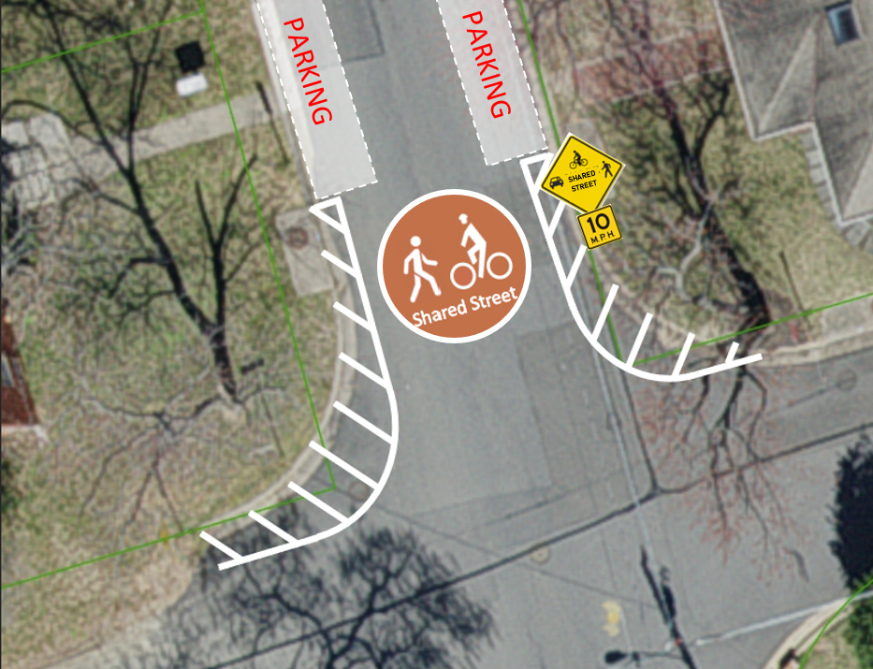
Proposed Street Entrance Concept
Marked within the bounds of the travel lane
20’
Minimum travel lane width maintained
Entrance to street narrowed using pavement markings, and or delineators
Notes:
Shown here is what a typical design could look like. Each street in this pilot program has different conditions which will affect the final design.

Slide 10
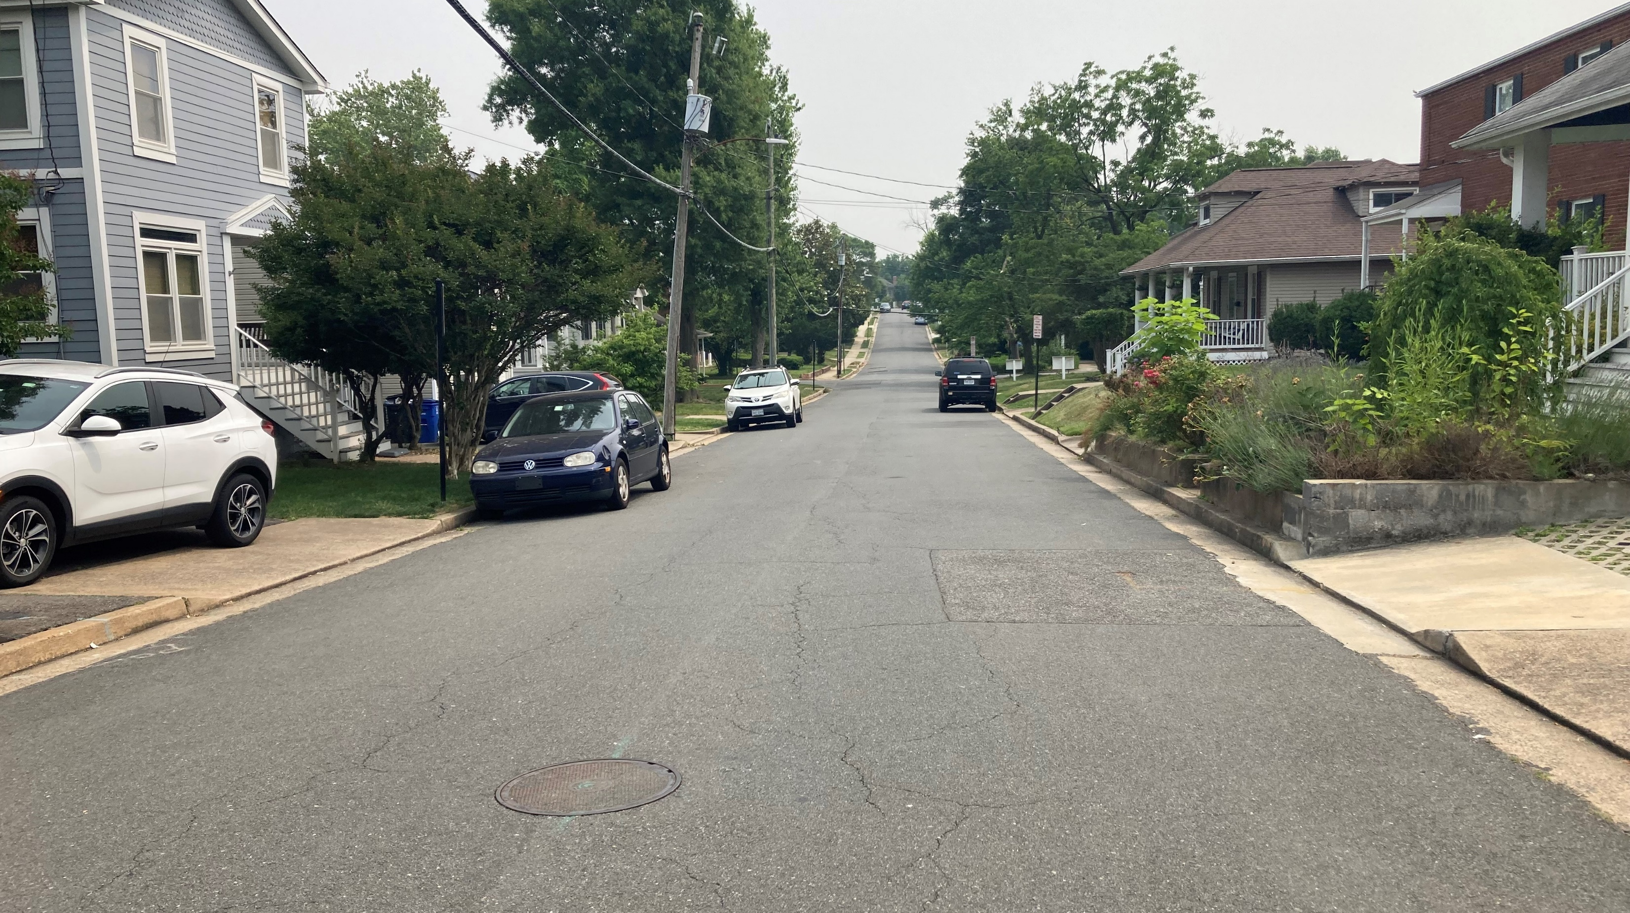
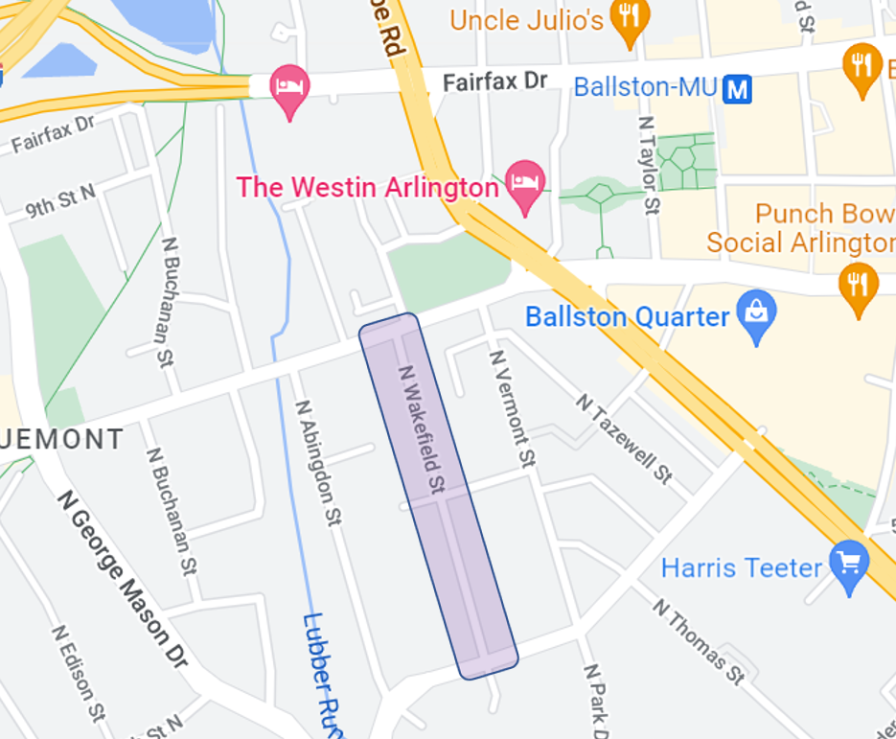
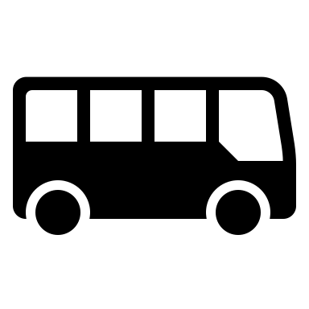
Pilot Project Qualifiers
N Wakefield Street
Carlin Springs to Wilson Blvd
Challenges
26’ curb to curb width
High parking demand
Utilities
Obstructions in the right of way
Lacks complete sidewalk infrastructure
Moderate ADT (1271)
Automobile Speeds range from 16 – 32mph
Proximity to commercial centers:
Ballston Quarter shops, and Grocery Stores
Near Escuela Key and Barrett Elementary Schools
Connects to bike lanes and routes
Near Capital Bikeshare stations
Proximity to transit stops
1A
1B
75
25B
Near Ballston - Marymount University Metro
Notes:
There are three locations where we will be trying the shared street concept.
1. N. Lynn Street from 20th to 16th Street in Aurora Highlands
S. 12 Street from S. Glebe Road to S. Highland Street in Douglas Park
Shown Here N. Wakefield Street
Each location is a bit different from the other, giving us the opportunity to explore how these treatments work in different contexts.
North Wakefield Street from Carlin Springs to Wilson Blvd. is nominated for many of the same reasons South Lynn Street and S. 12th Street is; it lacks complete sidewalk infrastructure, and is near many businesses, schools and pubic transit. N. Wakefield has the highest traffic volume of the three pilot project locations and the space in the public right of way is the most narrow and constrained.
What are the constraints
The curb to curb width along with high parking demand restricts the construction of sidewalk.
The presence of utilities, and the setbacks to houses and apartments are other factors which make constructing a sidewalk challenging.
The presence of street trees and landscaping
In addition to the project qualifiers, The moderate ADT at 1271, falls well within the recommended maximum ADT (1500) for shared streets according to the MTP. In addition the presence of pedestrian traffic and the wide range of vehicle speeds from 16 – 32mph and the need to reduce those speeds makes N. Wakefield a good fit for the pilot.

Slide 11
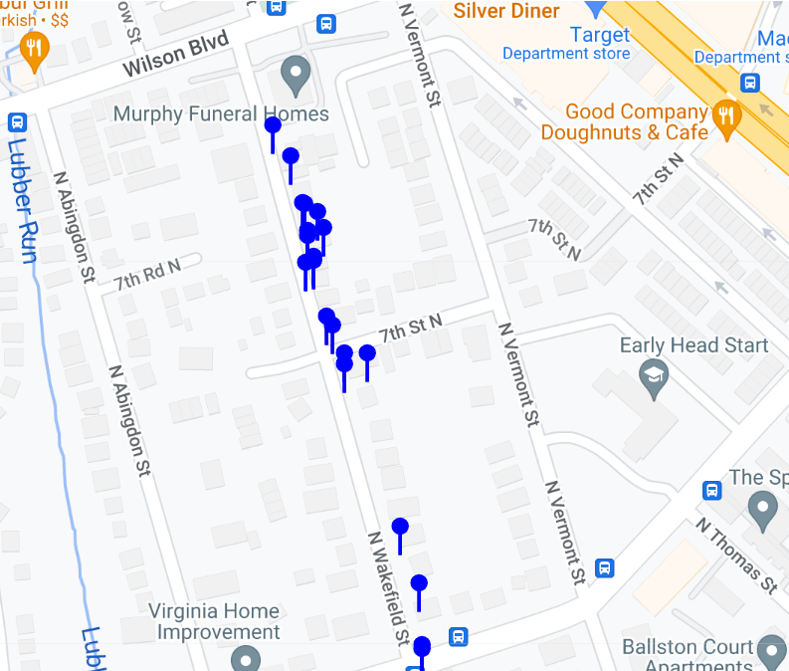
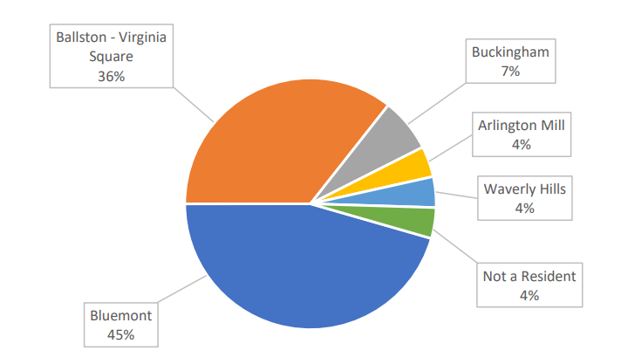
Public Engagement
52 people responded to our public feedback form, including 40 open ended comments and 20 location specific comments made using the online map.
Notes:
The first round of public engagement began November 6th and were closed on December 4th of 2023. The intent of this round of public engagement was to confirm our own observation and data, and to reveal any observations we may have missed. (we only see how the street operates briefly). The information and comments received in the public feedback form and the online map will be saved and referenced to gauge the effectiveness of the treatments one year after they have been installed.
Most of the commentors came from the Bluemont Neighborhood and surrounding Ballston, Buckingham and Waverly hills neighborhoods.

Slide 12
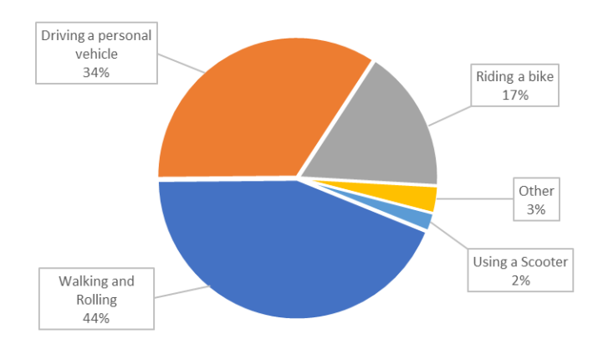
What we heard from you
When asked how someone moves along N. Wakefield Street, Respondents reported …
Notes:
Active Transportation makes up 63% of users on the roadway.

Slide 13
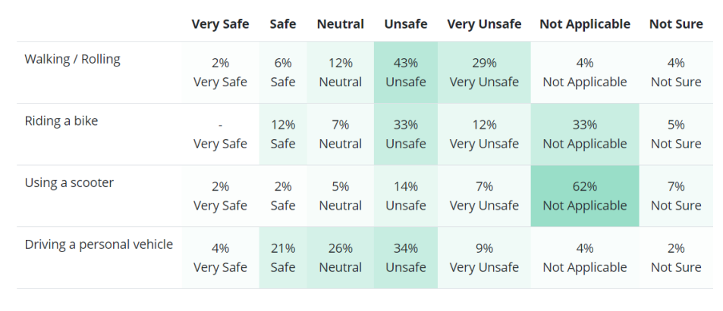
What we heard from you
When asked how safe do you feel while traveling N. Wakefield Street (Wilson Blvd. to N. Carlin Springs Rd.) using the following types of transportation Respondents Reported…
Notes:
While 43% of the respondents reported feeling unsafe, an additional 29% of respondents reported feeling very unsafe –72% of the respondents responded feeling generally unsafe
We asked 2 further questions about how people walking, rolling, riding a bike or scooter perceive the actions of drivers. To the first question how often do drivers yield to people walking in the street, most, 47% responded with sometimes. To the second question, how often do drivers drive at or under the posted 25mph speed limit, most, 37% responded with sometimes.

Slide 14
What we heard from you
Some of the major themes present in the open feedback and mapping tool were the…
Request for a sidewalk
Removal of parking to improve visibility and make room for a sidewalk.
The conversion of the street to a one-way road to restrict traffic and make room for a sidewalk.
Notes:
The desire of a sidewalk was reflected through many of the comments we received. It is something we are exploring with our engineers. However, the pilot project will continue to move forward. What makes providing a sidewalk difficult.
#3 – The Master Transportation Plan Streets Element advises against converting two-way streets to one-way streets (pg. 6, h)
1. Other goals and policies of the Street Element are to Maintain and enhance a grid-style street network
2. Permit those streets with relatively low traffic volumes (under 1,500 vehicles per day) and single family development to be narrowed and operate as “yield streets” (Serve as traffic Calming)
3. Enhance the connectivity of the existing street network by constructing new streets with redevelopment of large blocks and avoiding permanent closures or other reductions in street connectivity
Current Conditions, Yield Street Condition, encourage safer travel when cars approach one another. Both cars must slow down and one car must pull over to Yield.

Slide 15
Timeline – Next Steps
Public Engagement Winter, 2023
Design
Winter/Spring 2024
NCSC Funding Hearing Spring/Summer 2024
Implementation
Summer 2024
We are Here
Approval Required for
Project to Move Forward
Education
Location Specific
Experience Mapping
Designs Shared
Spring 2024
Feedback Forms

Slide 16
Questions
Contacts
Brian Shelton
Shared Street Project Manager:
bshelton@arlingtonva.us
Michelle Stafford
Neighborhood Complete Streets Program Manager:
mstafford@arlingtonva.us
Project Website:
https://www.arlingtonva.us/Government/Projects/Project-Types/Transportation-Projects/NCS-Shared-Street-Pilot
Or search online using this phrase:
“Neighborhood Complete Streets Shared Street Pilot Projects Arlington VA”

Slide 17
Neighborhood Complete Streets
Shared Streets Pilot Projects
Bluemont Civic Association
January 31, 2024
Brian Shelton – Project Manager
Michelle Stafford – NCS Program Manager

